Slide 1
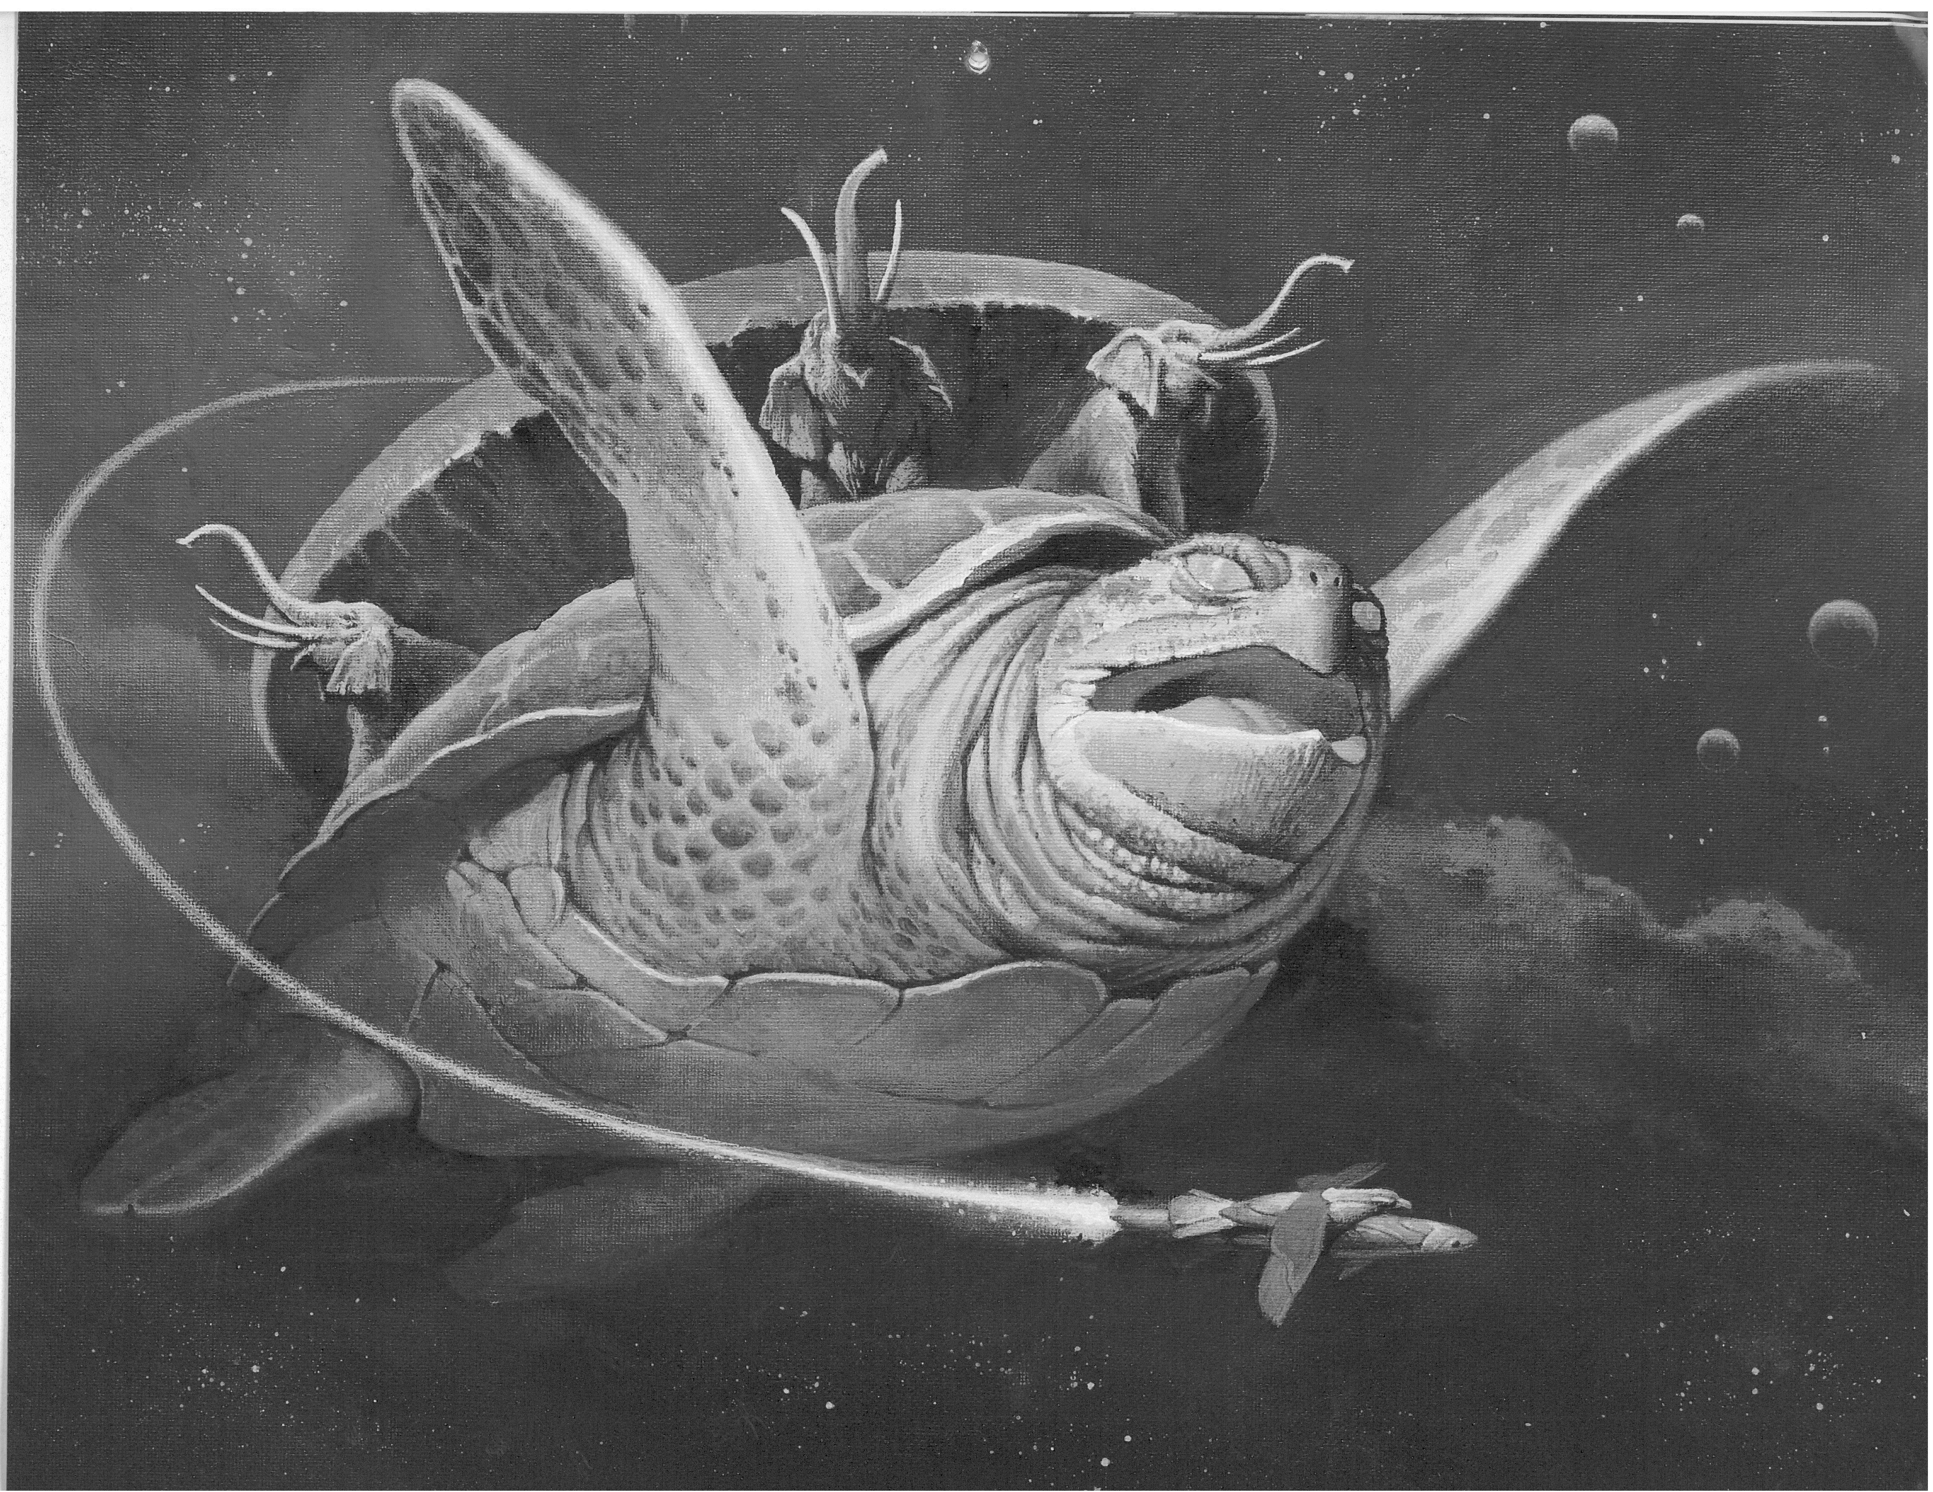
Competing in a flat world
How to create a global company and still be in Bulgaria
Competing in a flat world,
Victor K. Fung, William K. Fung and Yoram Wind, 2008
Background: Discworld by Terry Pratchett; pic from hdscreen.us

Slide 2
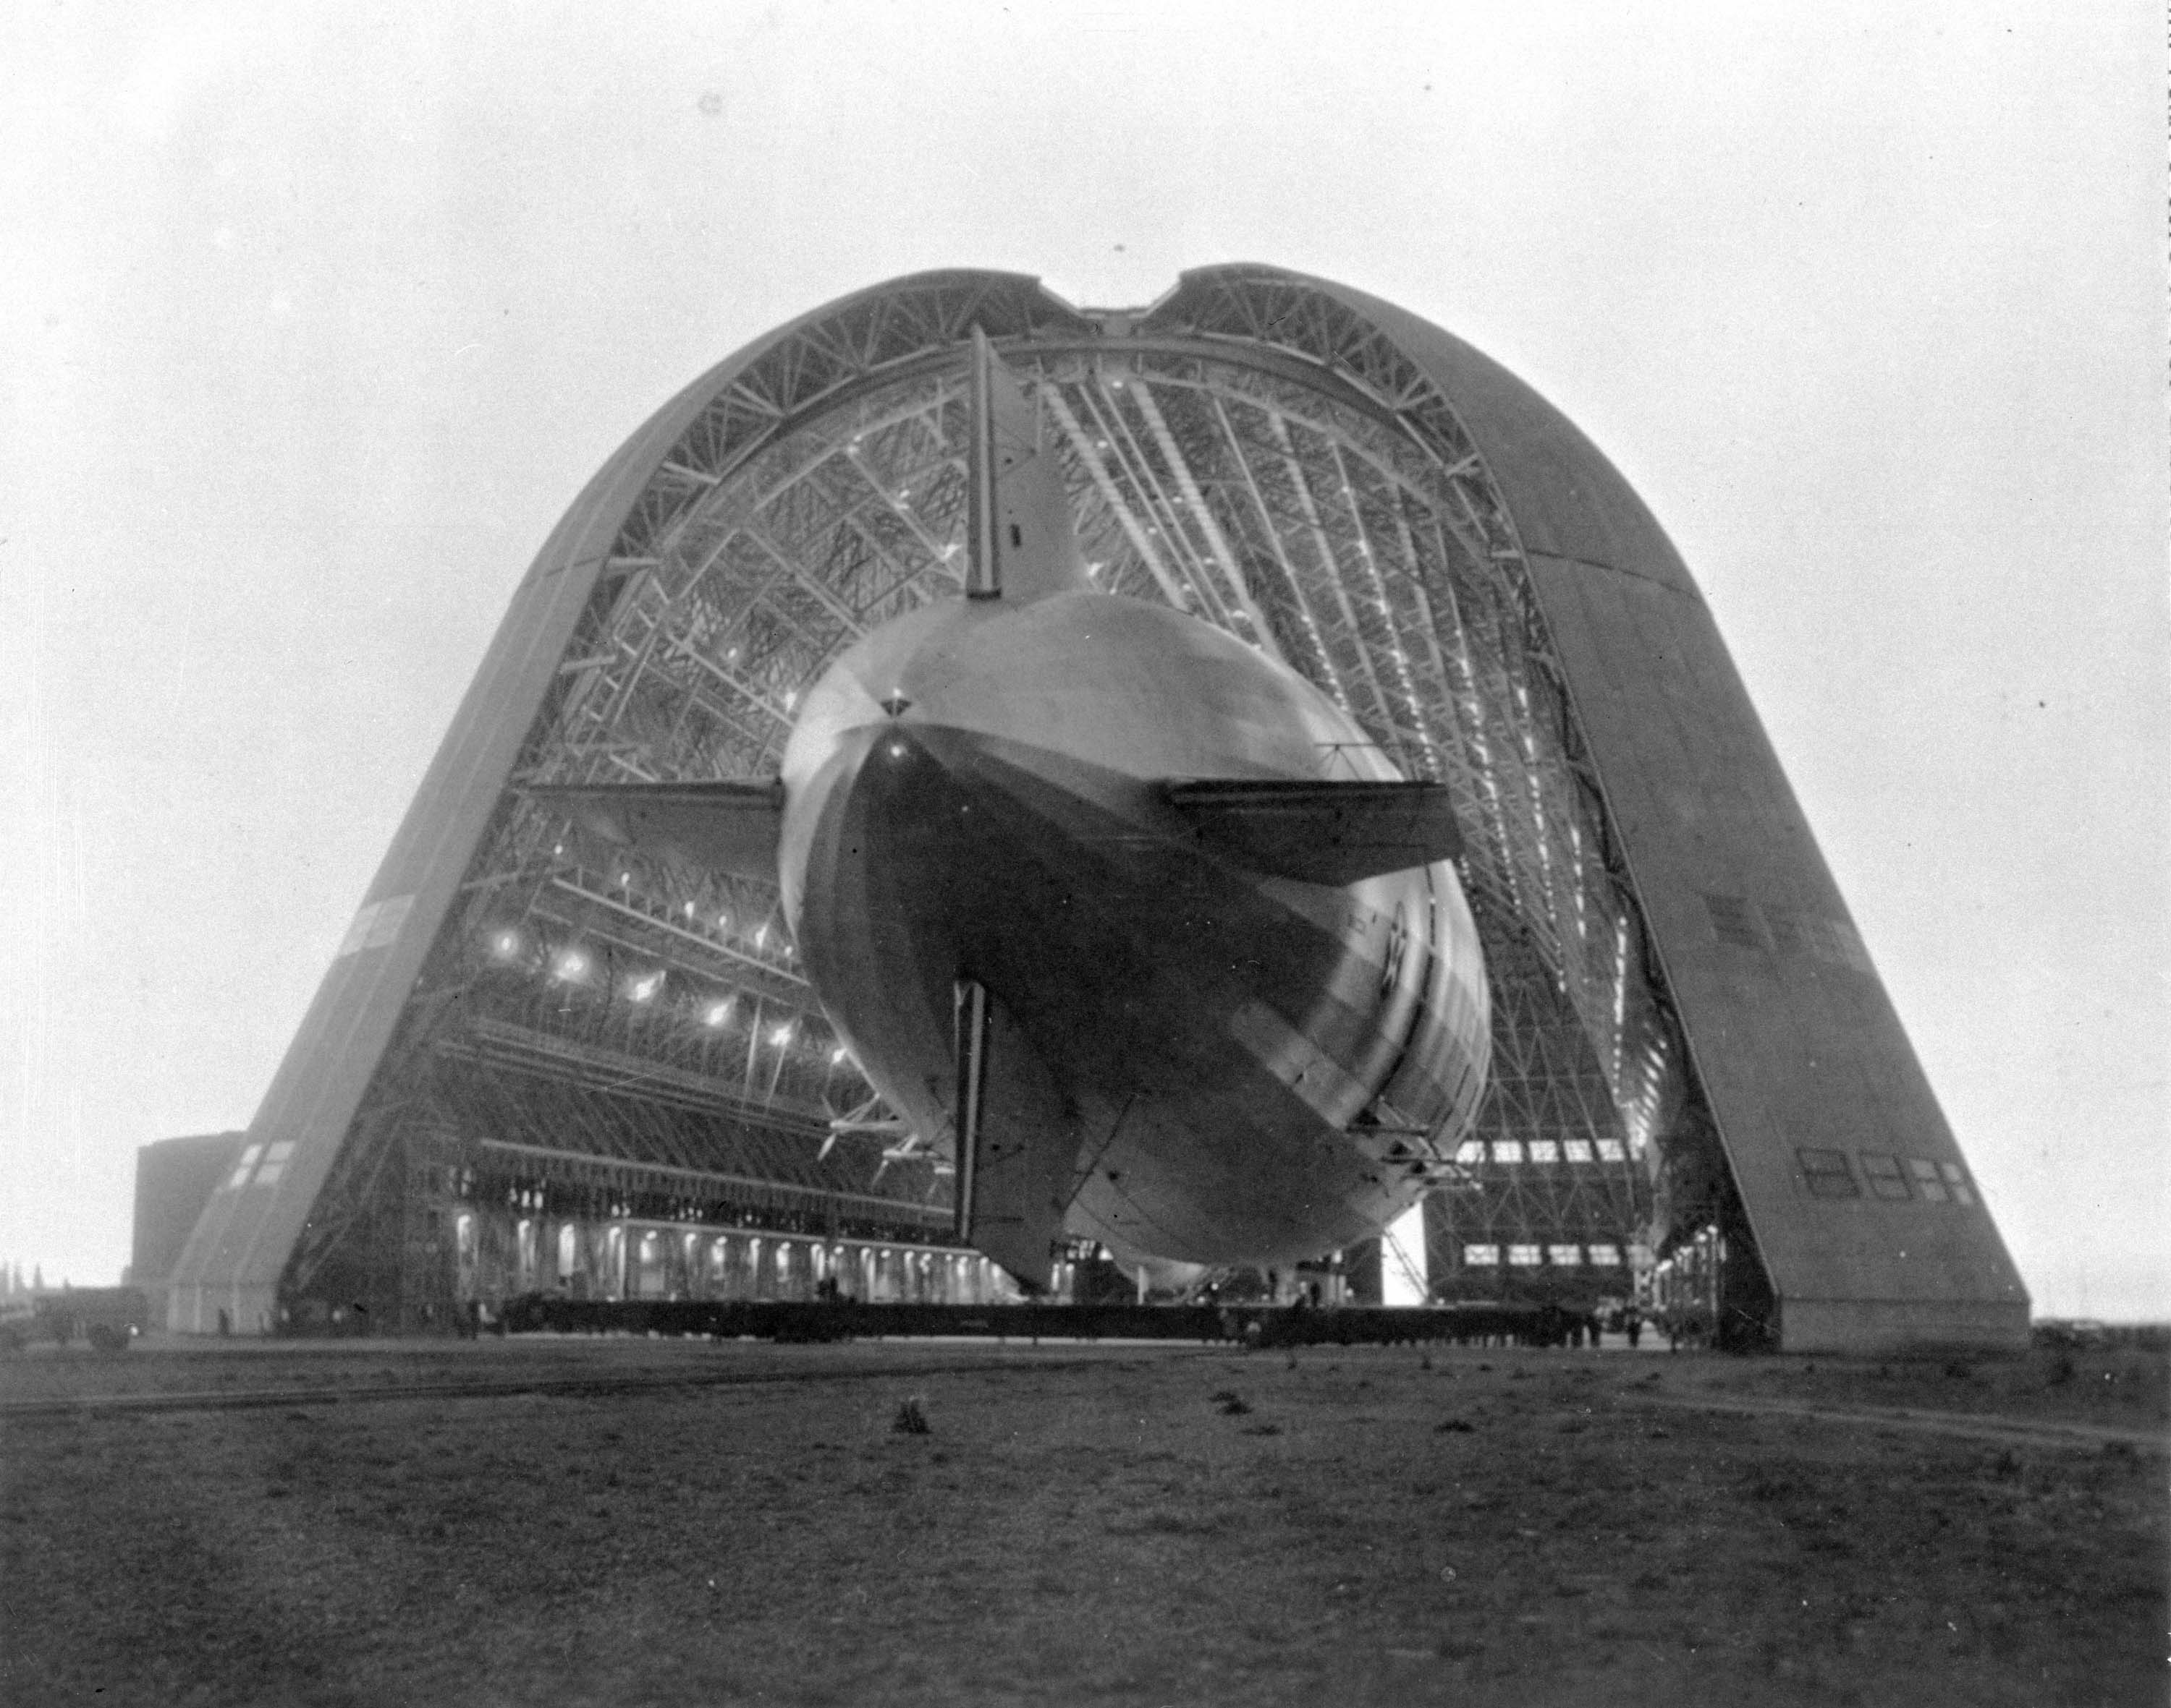

Slide 3



Slide 4
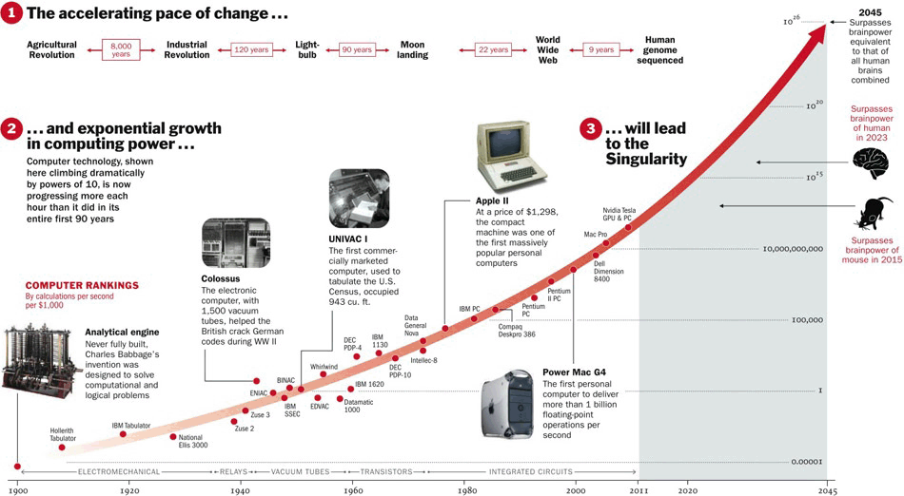
Source: reddit

Slide 5
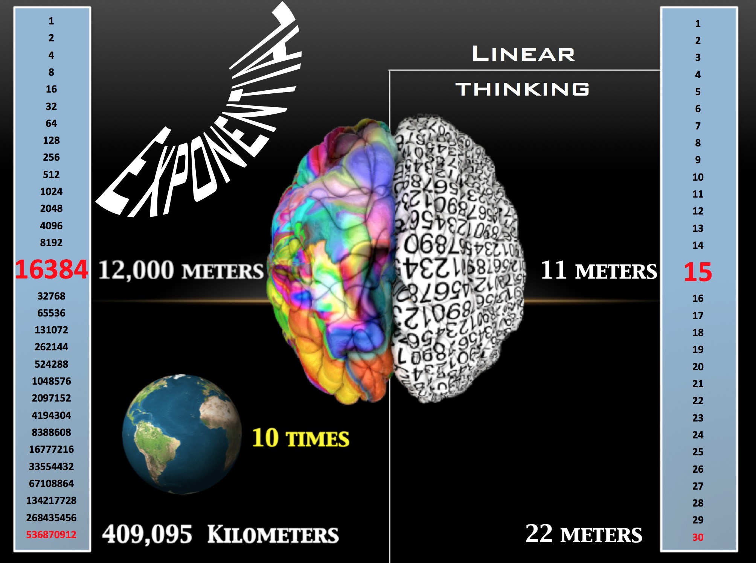
30 steps
Source: medhacker.com

Slide 6


Slide 7
What are ExOs?

Slide 8
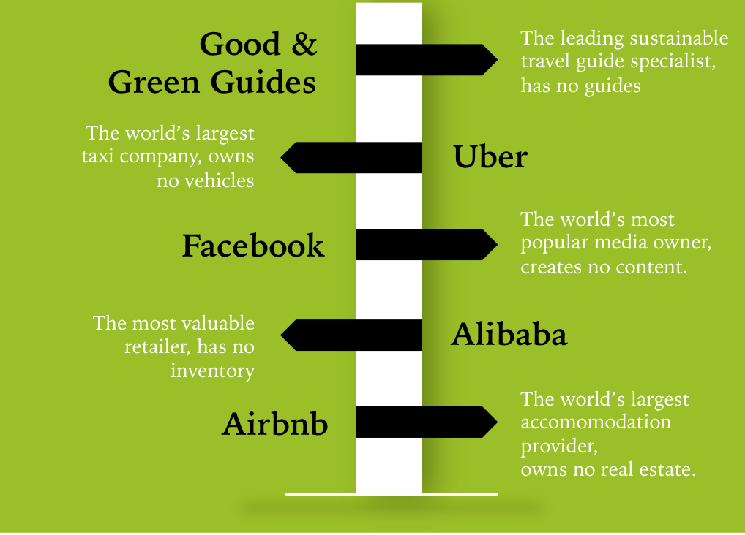
Definition
An Exponential Organization (ExO) is one whose impact (or output) is disproportionally large — at least 10x larger — compared to its peers because of the use of new organizational techniques that leverage exponential technologies.

Slide 9

Attributes

Slide 10
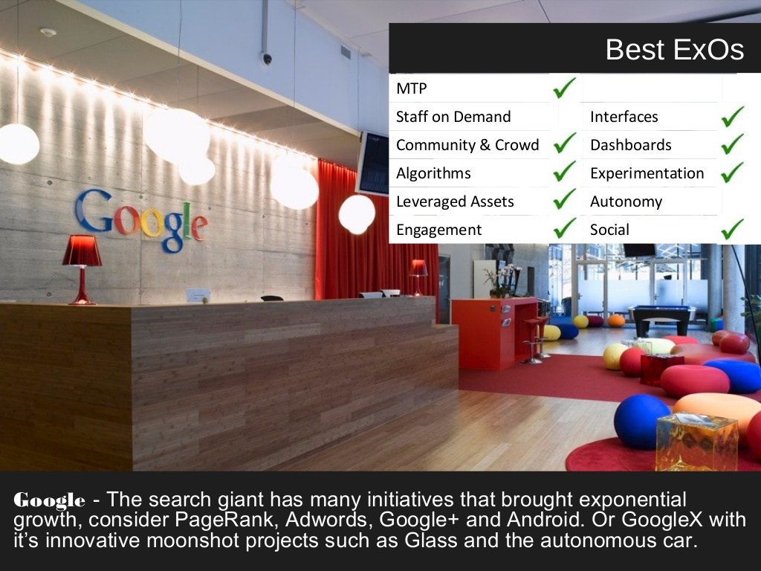

Slide 11


Slide 12
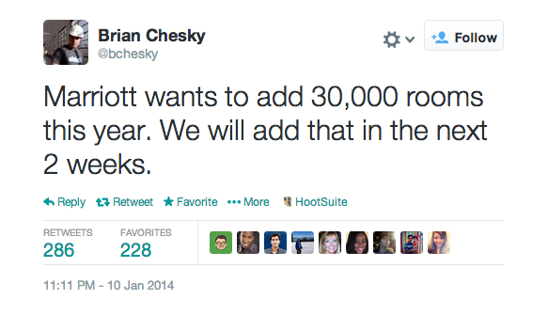

Slide 13














Companies that trusted us

Slide 14







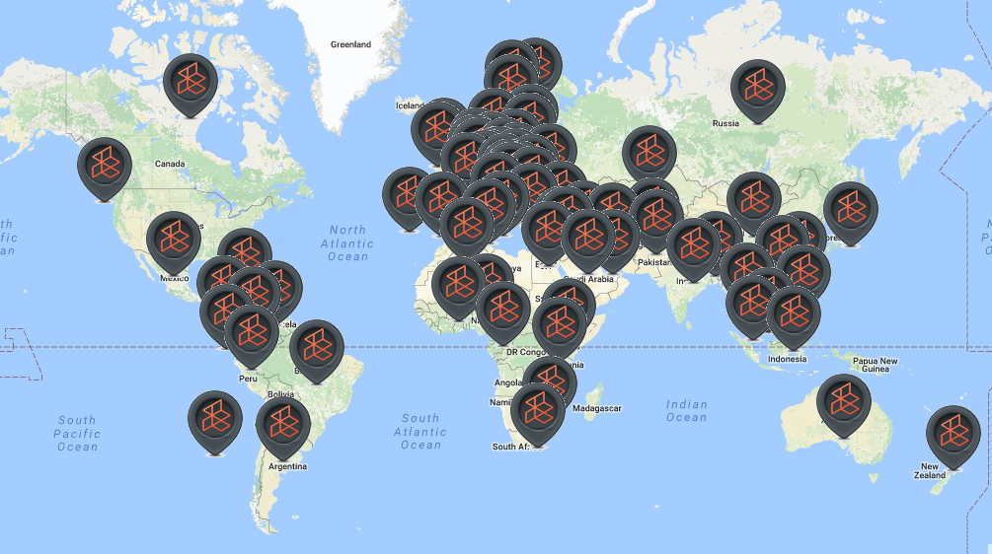




























Slide 15

Go build epic stuff! (ping me if you need help) teodor@coursedot.com

